Slide 1
BUS 297D: Data Mining
Professor David Mease
Lecture 8
Agenda:
1) Reminder about HW #4 (due Thursday, 10/15)
2) Lecture over Chapter 10
3) Discuss final exam + give sample questions

Slide 2
Homework 4
Homework 4 is at
http://www.cob.sjsu.edu/mease_d/bus297D/homework4.html
It is due Thursday, October 15 during class
It is work 50 points
It must be printed out using a computer and turned in during the class meeting time. Anything handwritten on the homework will not be counted. Late homeworks will not be accepted.

Slide 3
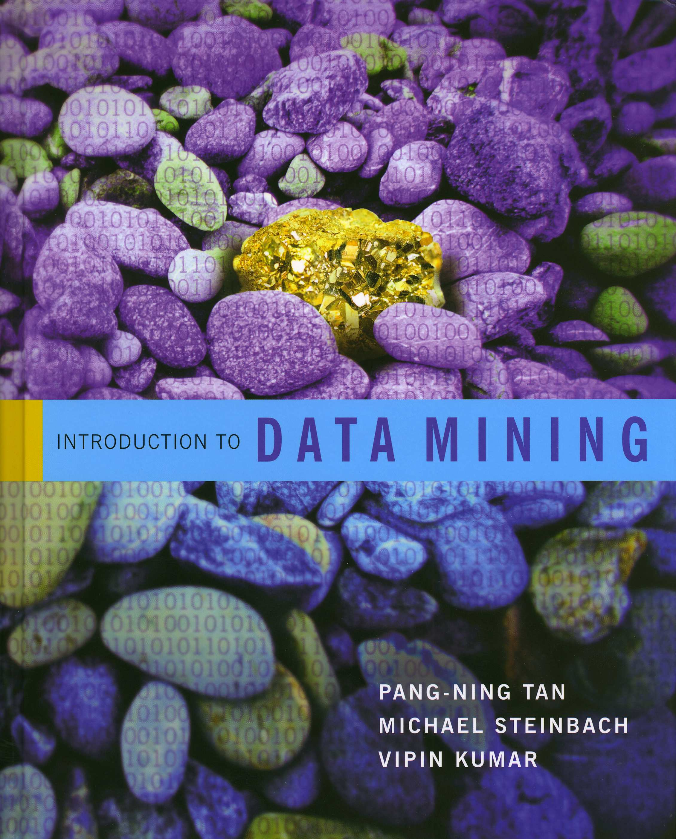
Introduction to Data Mining
by
Tan, Steinbach, Kumar
Chapter 10: Anomaly Detection

Slide 4
What is an Anomaly?
An anomaly is an object that is different from most of the other objects (p.651)
“Outlier” is another word for anomaly
“An outlier is an observation that differs so much from other observations as to arouse suspicion that it was generated by a different mechanism” (p. 653)
Some good examples of applications for anomaly detection are on page 652

Slide 5
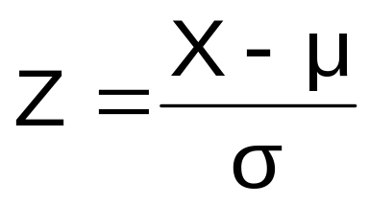
Detecting Outliers for a Single Attribute
A common method of detecting outliers for a single attribute is to look for observations more than a large number of standard deviations above or below the mean
The “z score” is the number of standard deviations above or below the mean (p. 661)
For the normal (bell-shaped) distribution we know the exact probabilities for the z scores
For non-normal distributions this approach is still useful and valid
A z score of 3 or -3 is a common cut off value

Slide 6
In class exercise #59:
For the second exam scores at
www.stats202.com/exams_and_names.csv
use a z score cut off of 3 to identify any outliers.

Slide 7
In class exercise #59:
For the second exam scores at
www.stats202.com/exams_and_names.csv
use a z score cut off of 3 to identify any outliers.
Solution:
data<-read.csv("exams_and_names.csv")
exam2mean<-mean(data[,3],na.rm=TRUE)
exam2sd<-sd(data[,3],na.rm=TRUE)
z<-(data[,3]-exam2mean)/exam2sd
sort(z)

Slide 8
In class exercise #60:
Compute the count of each ip address (1st column) in the data www.stats202.com/more_stats202_logs.txt
Then use a z score cut off of 3 to identify any outliers for these counts.

Slide 9
Detecting Outliers for a Single Attribute
A second popular method of detecting outliers for a single attribute is to look for observations more than a large number of IQR’s above the 3rd quartile or below the 1st quartile (the IQR is the interquartile range = Q₃-Q₁)
This approach is used in R by default in the boxplot function
The default value in R is to identify outliers more than 1.5 IQR’s above the 3rd quartile or below the 1st quartile
This approach is thought to be more robust than the z score because the mean and standard deviation are sensitive to outliers (but not the quartiles)

Slide 10
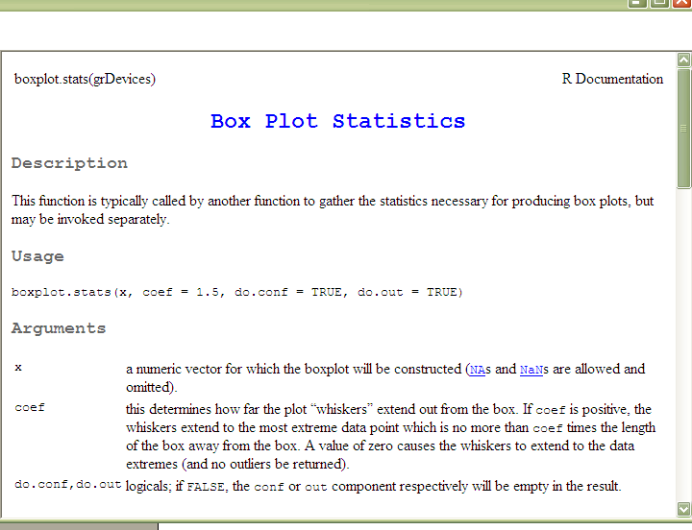

Slide 11
In class exercise #61:
For the second exam scores at
www.stats202.com/exams_and_names.csv
identify any outliers more than 1.5 IQR’s above the 3rd quartile or below the 1st quartile. Verify that these are the same outliers found by the boxplot function in R.

Slide 12
In class exercise #61:
For the second exam scores at
www.stats202.com/exams_and_names.csv
identify any outliers more than 1.5 IQR’s above the 3rd quartile or below the 1st quartile. Verify that these are the same outliers found by the boxplot function in R.
Solution:
data<-read.csv("exams_and_names.csv")
q1<-quantile(data[,3],.25,na.rm=TRUE)
q3<-quantile(data[,3],.75,na.rm=TRUE)
iqr<-q3-q1
data[(data[,3]>q3+1.5*iqr),3]
data[(data[,3]<q1-1.5*iqr),3]

Slide 13
In class exercise #61:
For the second exam scores at
www.stats202.com/exams_and_names.csv
identify any outliers more than 1.5 IQR’s above the 3rd quartile or below the 1st quartile. Verify that these are the same outliers found by the boxplot function in R.
Solution (continued):
boxplot(data[,2],data[,3],col="blue",
main="Exam Scores",
names=c("Exam 1","Exam 2"),ylab="Exam Score")

Slide 14
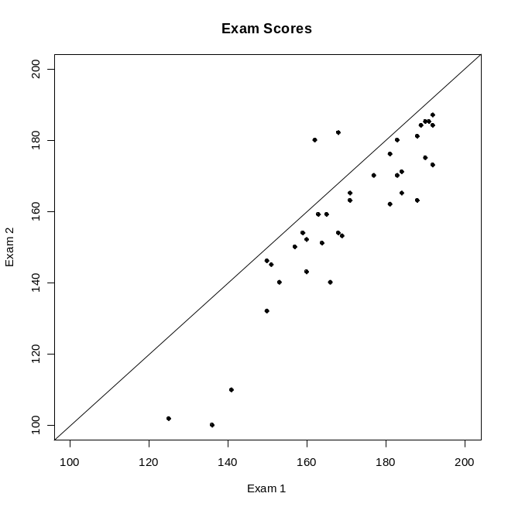
Detecting Outliers for Multiple Attributes
For the data www.stats202.com/exams_and_names.csv
there are two students who did better on exam 2 than exam 1.
Our single attribute approaches would not identify these as outliers since they are not outliers on either attribute
So for multiple attributes we need some other approaches
There are 4 techniques in Chapter 10 that may work well here. They are listed on the next slide.

Slide 15
Detecting Outliers for Multiple Attributes
Mahalanobis distance (p. 662) - This is a distance measure that takes correlation into account
Proximity-based outlier detection (p. 666) - Points are identified as outliers if they are far from most other points
Model based techniques (p. 654) - Points which don’t fit a certain model well are identified as outliers
Clustering based techniques (p. 671) - Points are identified as outliers if they are far from all cluster centers (or if they form their own small cluster with only a few points)

Slide 16
Proximity-Based Outlier Detection (p. 666)
Points are identified as outliers if they are far from most other points
One method is to identify points as outliers if their distance to their k^{th} nearest neighbor is large
Choosing k is tricky because it should not be too small or too big
Page 667 has some good examples with k=5

Slide 17
Model Based Techniques (p. 654)
First build a model
Points which don’t fit the model well are identified as outliers
For the example at the right, a least squares regression model would be appropriate

Slide 18
In class exercise #62:
Use the function lm in R to fit a least squares regression model which predicts the exam 2 score as a function of the exam 1 score for the data at
www.stats202.com/exams_and_names.csv
Plot the fitted line and determine for which points the fitted exam 2 values are the furthest from the actual values using the model residuals.

Slide 19
In class exercise #62:
Use the function lm in R to fit a least squares regression model which predicts the exam 2 score as a function of the exam 1 score for the data at
www.stats202.com/exams_and_names.csv
Plot the fitted line and determine for which points the fitted exam 2 values are the furthest from the actual values using the model residuals.
Solution:
data<-read.csv("exams_and_names.csv")
model<-lm(data[,3]~data[,2])
plot(data[,2],data[,3],pch=19,xlab="Exam 1", ylab="Exam2",xlim=c(100,200),ylim=c(100,200))
abline(model)
sort(model$residuals)

Slide 20
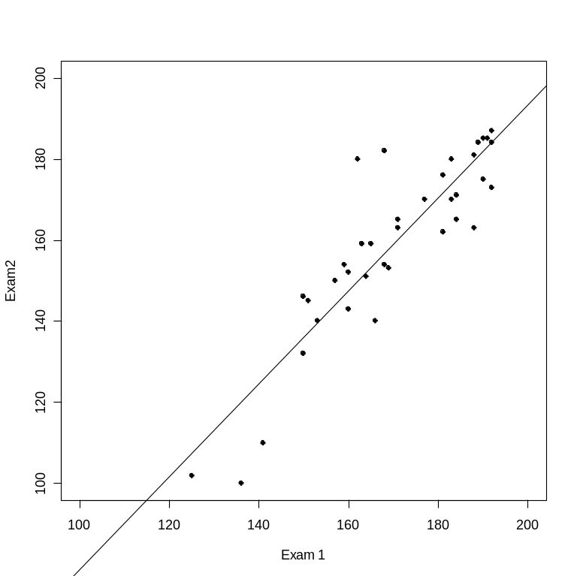
In class exercise #62:
Use the function lm in R to fit a least squares regression model which predicts the exam 2 score as a function of the exam 1 score for the data at
www.stats202.com/exams_and_names.csv
Plot the fitted line and determine for which points the fitted exam 2 values are the furthest from the actual values using the model residuals.
Solution (continued):

Slide 21
Clustering Based Techniques (p. 671)
Clustering can be used to find outliers
One approach is to compute the distance of each point to its cluster center and identify points as outliers for which this distance is large
Another approach is to look for points that form clusters containing very few points and identify these points as outliers

Slide 22
In class exercise #63:
Use kmeans() in R with all the default values to find the k=5 solution for the data at
www.stats202.com/exams_and_names.csv
Plot the data. Also plot the fitted cluster centers using a different color. Finally, use the knn() function to assign the cluster membership for the points to the nearest cluster center. Color the points according to their cluster membership. Do the two people who did better on exam 2 than exam 1 form their own cluster?

Slide 23
In class exercise #63:
Use kmeans() in R with all the default values to find the k=5 solution for the data at
www.stats202.com/exams_and_names.csv
Plot the data. Also plot the fitted cluster centers using a different color. Finally, use the knn() function to assign the cluster membership for the points to the nearest cluster center. Color the points according to their cluster membership. Do the two people who did better on exam 2 than exam 1 form their own cluster?
Solution:
data<-read.csv("exams_and_names.csv")
x<-data[!is.na(data[,3]),2:3]

Slide 24
In class exercise #63:
Use kmeans() in R with all the default values to find the k=5 solution for the data at
www.stats202.com/exams_and_names.csv
Plot the data. Also plot the fitted cluster centers using a different color. Finally, use the knn() function to assign the cluster membership for the points to the nearest cluster center. Color the points according to their cluster membership. Do the two people who did better on exam 2 than exam 1 form their own cluster?
Solution (continued):
plot(x,pch=19,xlab="Exam 1",ylab="Exam 2")
fit<-kmeans(x,5)
points(fit$centers,pch=19,col="blue",cex=2)
library(class)
knnfit<-knn(fit$centers,x,as.factor(c(1,2,3,4,5)))
points(x,col=as.numeric(knnfit),pch=19)

Slide 25
Final Exam:
The final exam will be Thursday 10/15
Just like with the midterm, you are allowed one 8.5 x 11 inch sheet (front and back) containing notes
No books or computers are allowed, but please bring a hand held calculator
The exam will cover the material from Lectures 5, 6, 7 and 8 and Homeworks #3 and #4 (Chapters 4, 5, 8 and 10) so it is not cumulative
I have some sample questions on the next slides
In general the questions will be similar to the homework questions (much less multiple choice this time)

Slide 26
Sample Final Exam Question #1:
Which of the following describes bagging as discussed in class?
A) Bagging combines simple base classifiers by upweighting data points which are classified incorrectly
B) Bagging builds different classifiers by training on repeated samples (with replacement) from the data
C) Bagging usually gives zero training error, but rarely overfits which is very curious
D) All of these

Slide 27
Sample Final Exam Question #2:
Homework 3 question #2

Slide 28
Sample Final Exam Question #3:
Homework 3 question #3

Slide 29
Sample Final Exam Question #4:
Homework 3 question #4

Slide 30
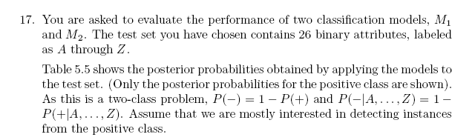
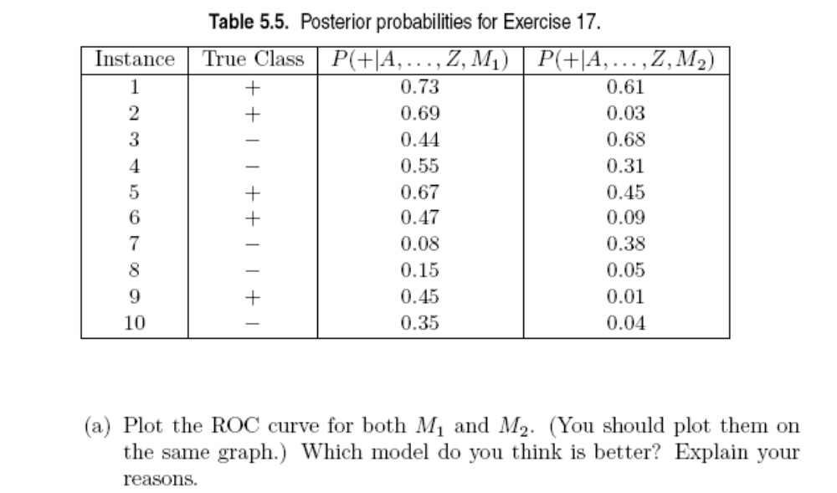
Sample Final Exam Question #5:
Chapter 5 textbook problem #17 part a:

Slide 31
Sample Final Exam Question #6:
Compute the precision, recall, F-measure and misclassification error rate with respect to the positive class when a cutoff of P=.50 is used for model M₂.

Slide 32
Sample Final Exam Question #7:
For the one dimensional data at the right,
give the k-nearest neighbor classifier for
the points x=2, x=10 and x=120 using k=5.
x | y
2 | 1
4 | -1
6 | 1
8 | -1
10 | 1
15 | -1
20 | 1
25 | -1
30 | 1
35 | -1
40 | 1
45 | -1
50 | 1
55 | -1
60 | 1
65 | -1
70 | 1
75 | -1
80 | 1
85 | -1
90 | 1
95 | -1
100 | 1
200 | -1

Slide 33
Sample Final Exam Question #8:
Consider the one-dimensional data set given by
x<-c(1,2,3,5,6,7,8) (I left out 4 on purpose). Starting with initial cluster center values of 1 and 2 carry out algorithm 8.1 until convergence by hand for k=2 clusters. Show the cluster membership and cluster centers for each iteration.

Slide 34
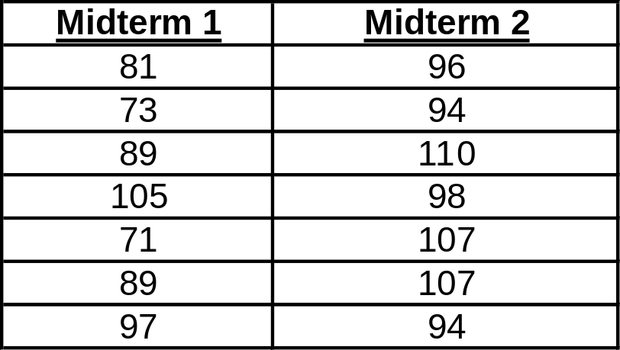
Sample Final Exam Question #9:
For the Midterm 1 and Midterm 2 scores listed below use a z score cut off of +/-3 to identify any outliers for each midterm. Show all your work.

